Slide 1



Promoting tax and investment reforms in developing countries since 1993

Slide 2
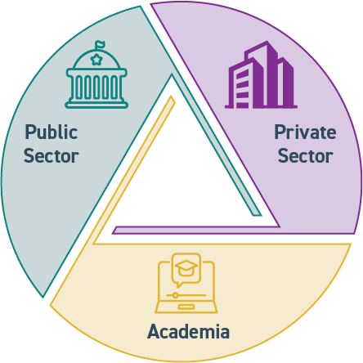
An independent, nonprofit research and education organization
The International Tax and Investment Center (ITIC) is an independent, nonprofit research and education organization founded in 1993 to promote tax reform and public-private initiatives to improve the investment climate in transition and developing economies.
ITIC is a respected, credible broker of public-private tax dialogue that facilitates mutual understanding and trust between business and government through the ITIC neutral table, where stakeholders convene to discuss academic analyses, policy studies and international best practices.
Connecting People and Resources

Slide 3
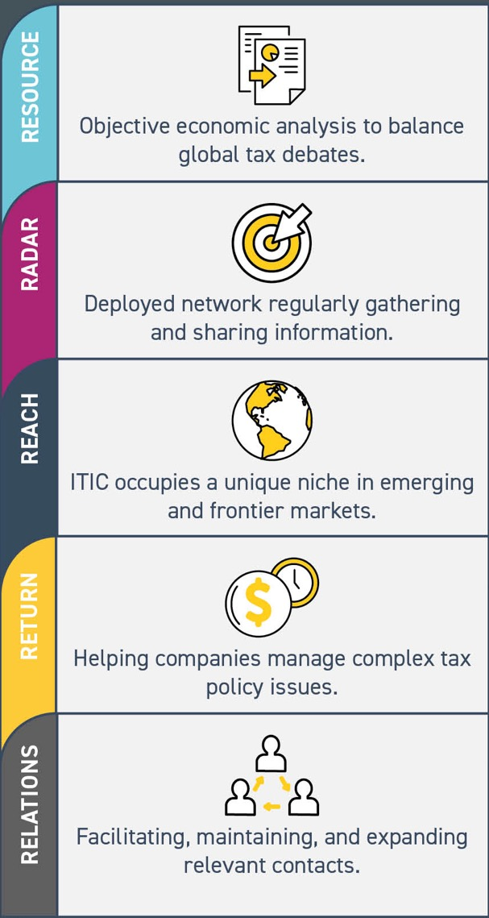
ITIC serves as a clearinghouse for information on best practices in tax and investment policy.

Slide 4

Thought Leadership
ITIC’s thought leadership and capacity-building programs provide analytic support for tax and investment reforms leading to job creation; poverty reduction; improved living standards; sustainable and inclusive economic growth; and movement from the shadow economy to the formal sector.
Stakeholder Engagement
ITIC works with ministries of finance, customs services, and revenue authorities worldwide, as well as international and regional financial institutions engaged in tax policy and tax administration issues. ITIC’s efforts are supported by corporate sponsors around the world.
Communications & Outreach
ITIC maintains a global communications network through which it delivers issue- and sector-specific expert studies, internationally published articles, webinars, and e-newsletters to enhance peer learning and educate stakeholders on best practices.

Slide 5

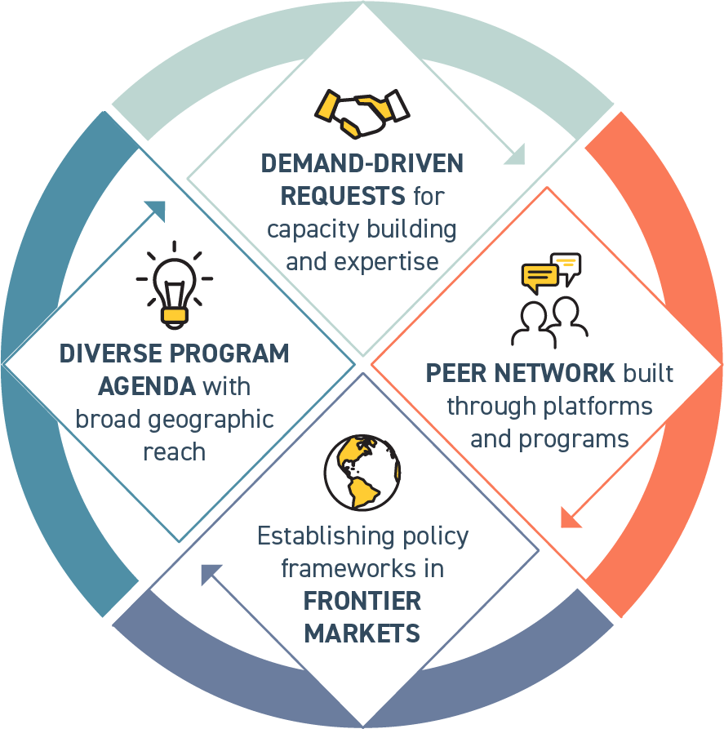
Delivering value to public- and private- sector stakeholders.
ITIC’s global thematic initiatives and country-specific/regional projects contribute to pro-growth fiscal policies; effective and transparent tax administration; predictable international trade and investment practices; and alignment of tax and revenue objectives.

Slide 6
